Slide 1
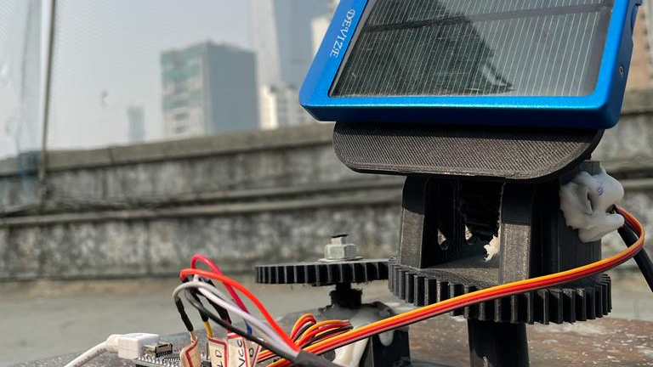

Dual Axis Solar Tracker

Slide 2

Introduction
What?
Why?
How?

Slide 3


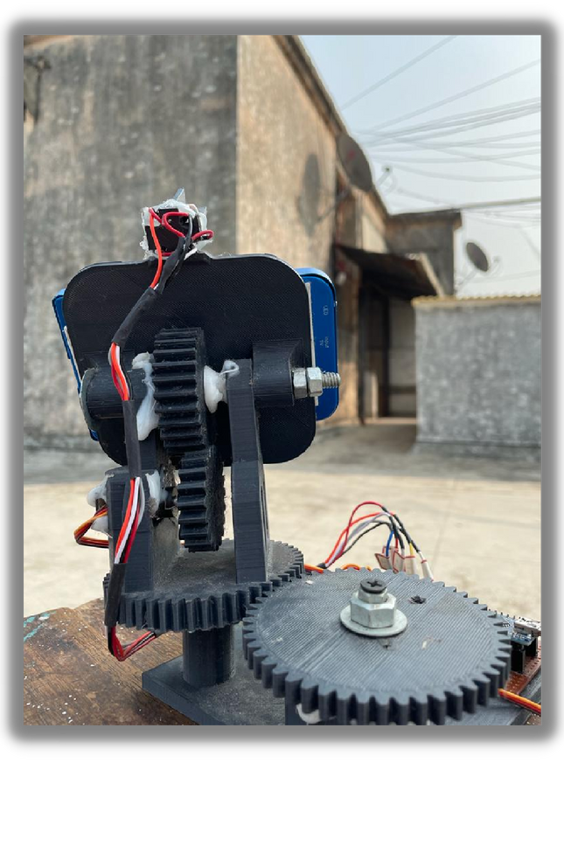
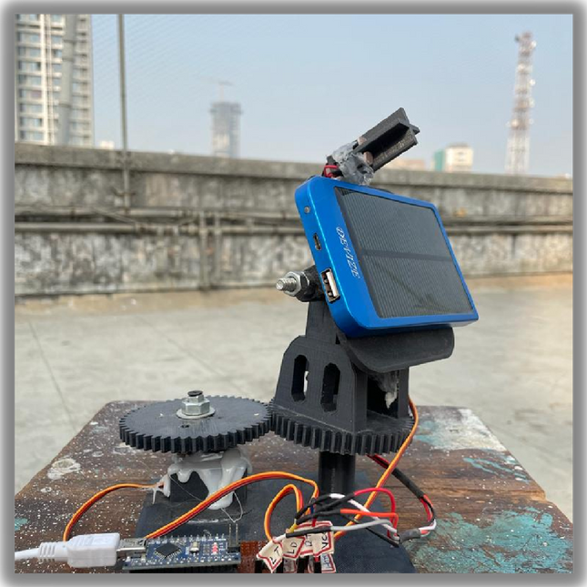
PHOTO GALLERY
Front View

Slide 4
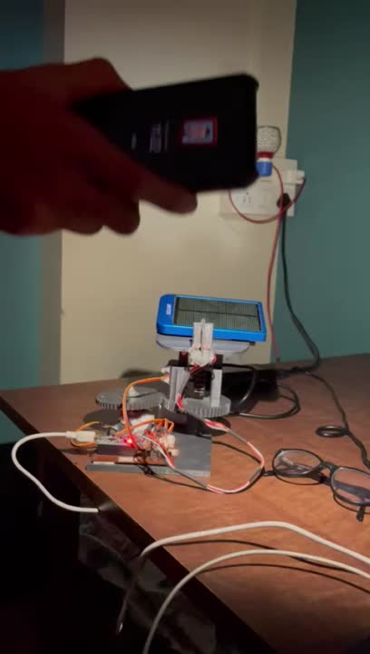
VIDEO DEMO
Here's the working of solar panel tracker under artificial lighting.

Slide 5
Components and
devices

Slide 6
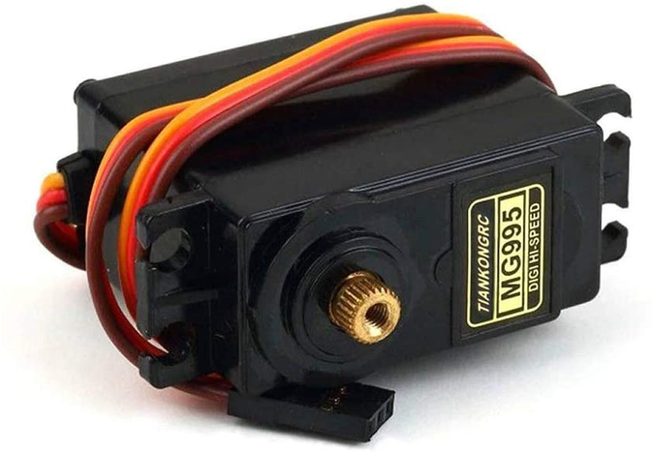
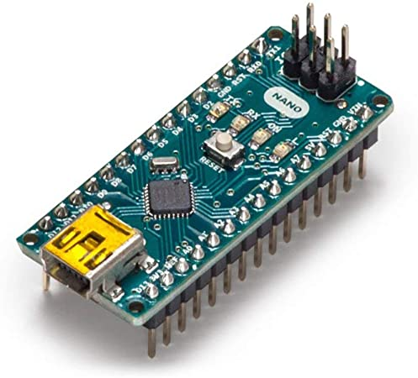
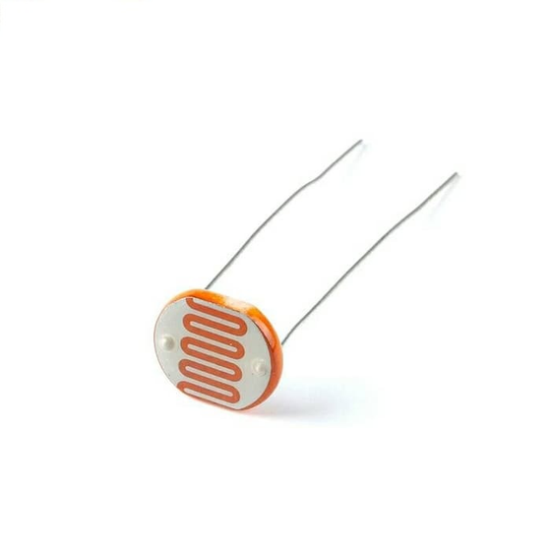
SERVO MOTOR MG995
.Part of the mechanical system.
Rs.180
ARDUINO NANO
Microcontroller board used for the main control circuitry.
Rs.300
LIGHT DEPENDENT RESISTOR
FOR PROVIDING FEED BACK .
Rs.8

Slide 7
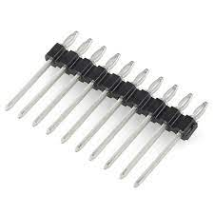
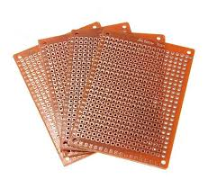
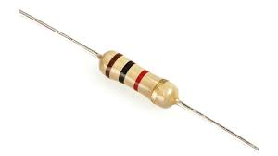
HEADER PINS
used for connecting the circuit
Rs.50
Universal Circuit Board
MY EXPERTISE
For Circuit Assembly
RESISTOR
Rs.50
USED IN FEEDBACK SYSEM
Rs.10

Slide 8
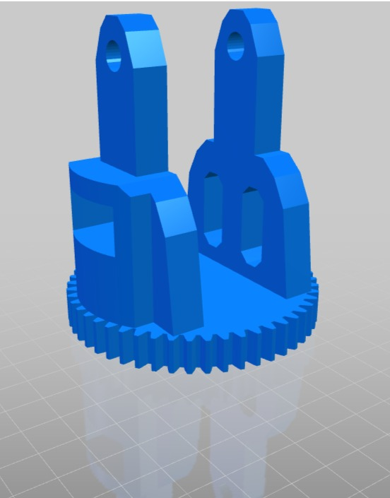
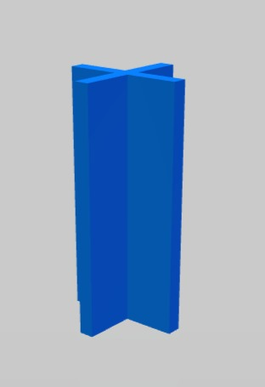
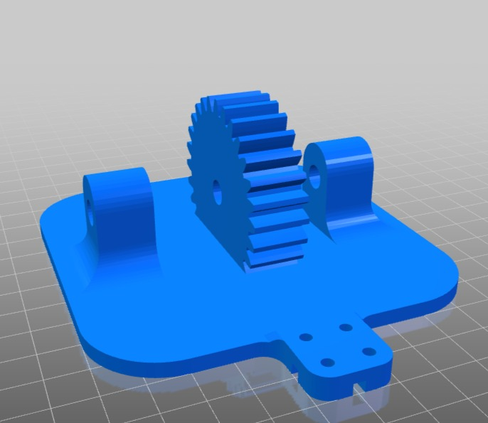
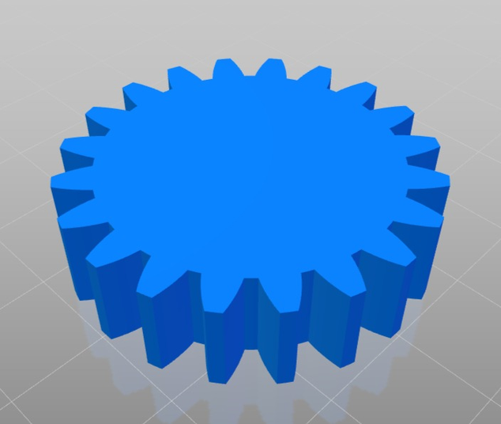
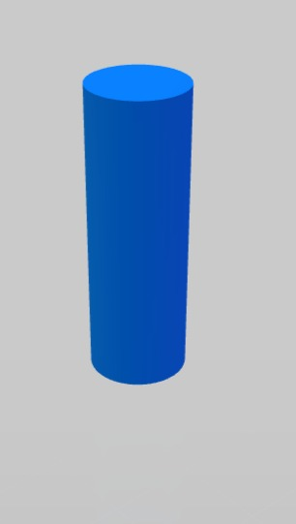
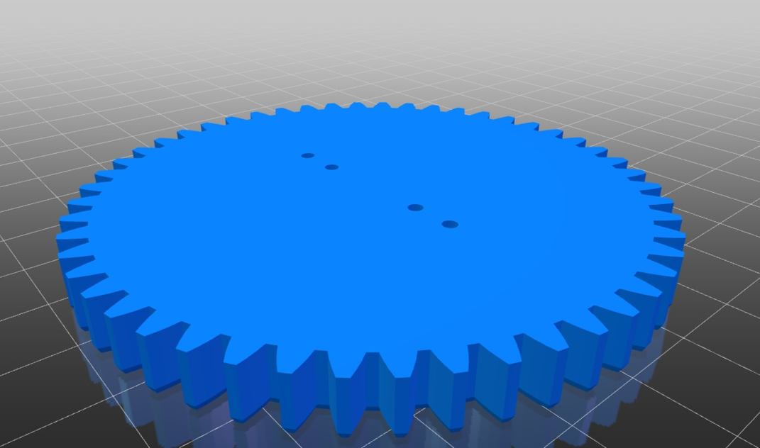
Construction

Slide 9
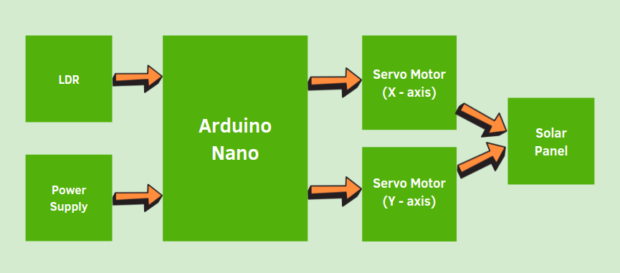
BLOCK DIAGRAM

Slide 10
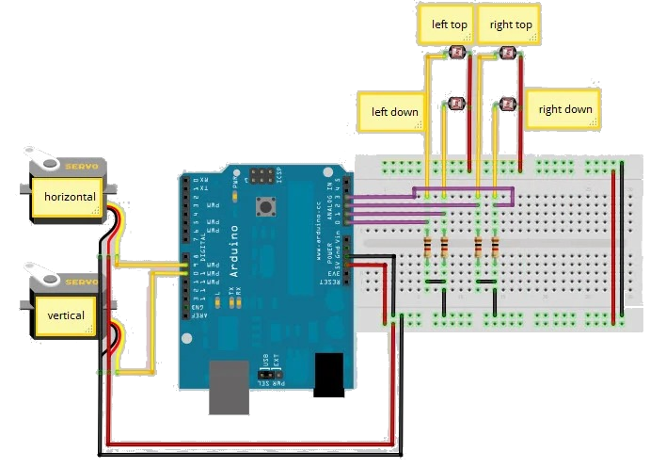
Circuit Diagram

Slide 11
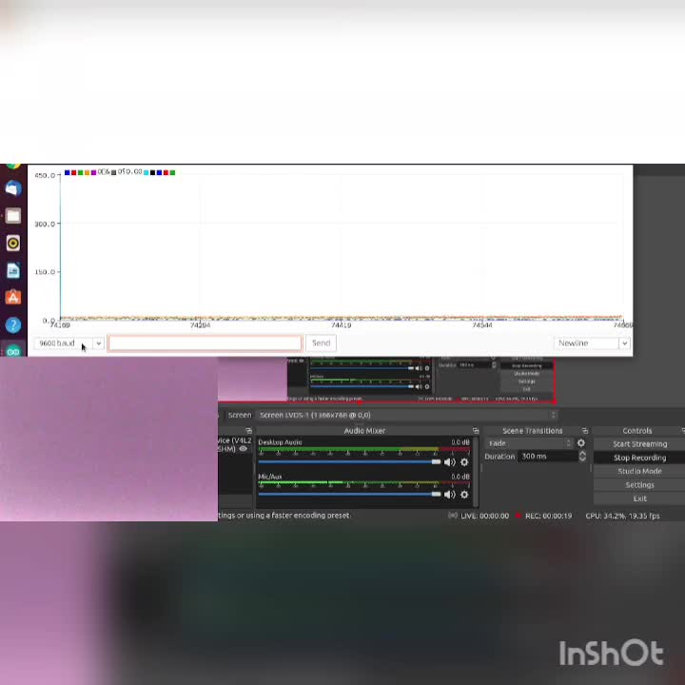
Feedback Signals
-- LT
-- RT
-- LD
-- RD

Slide 12
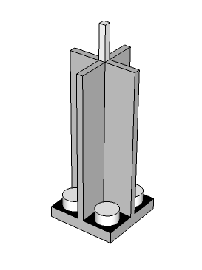
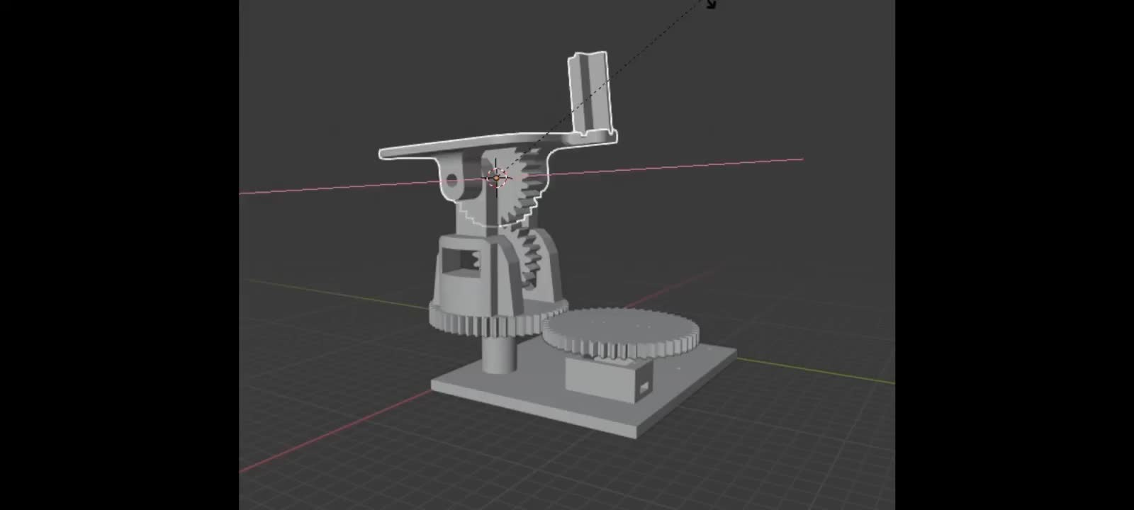
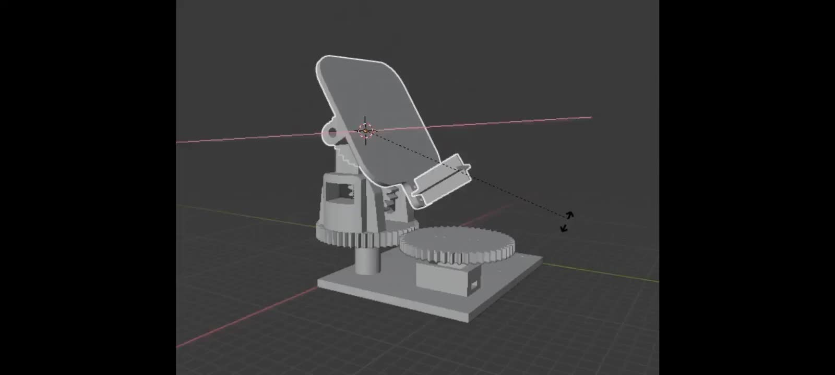
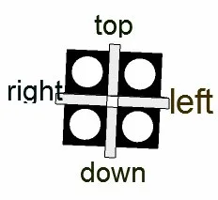
TRACKING ALGORITHM
Vertical Axis

Slide 13
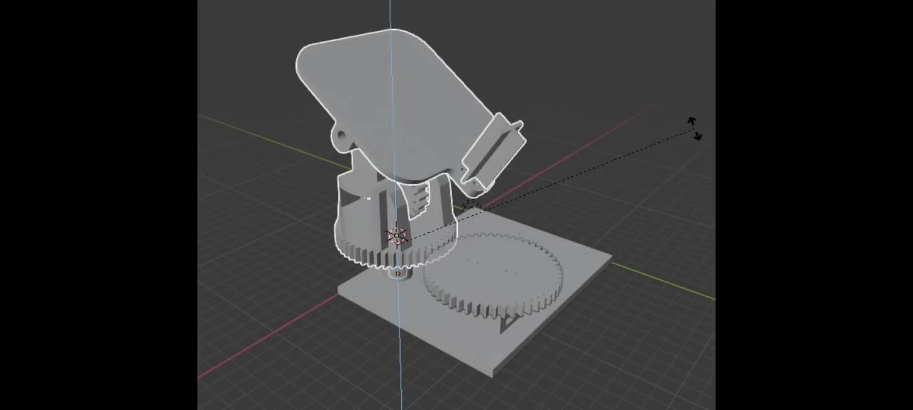
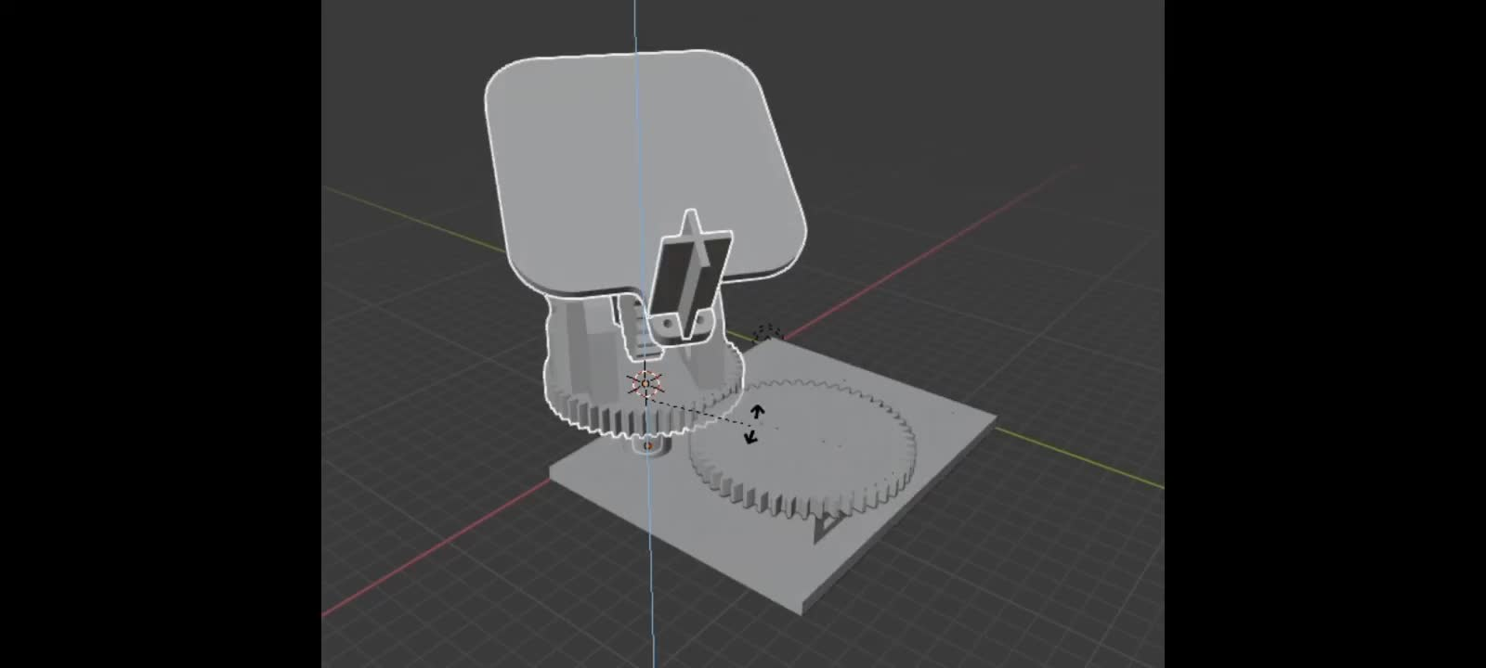
TRACKING ALGORITHM
Horizontal Axis

Slide 14
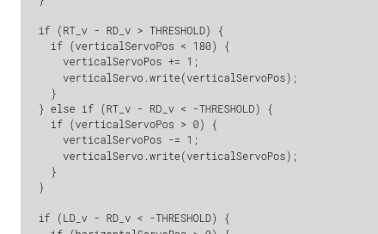
Program Extract

Slide 15
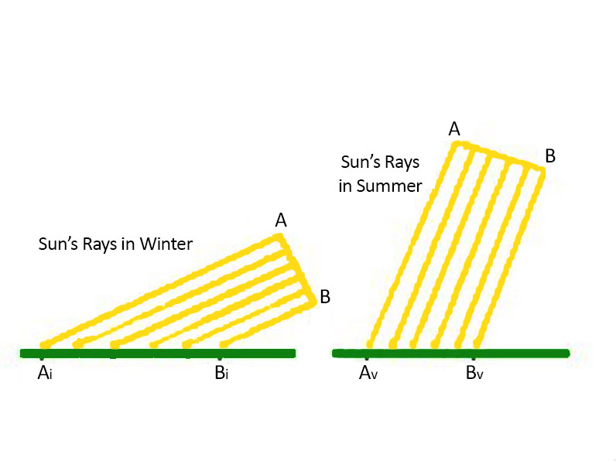
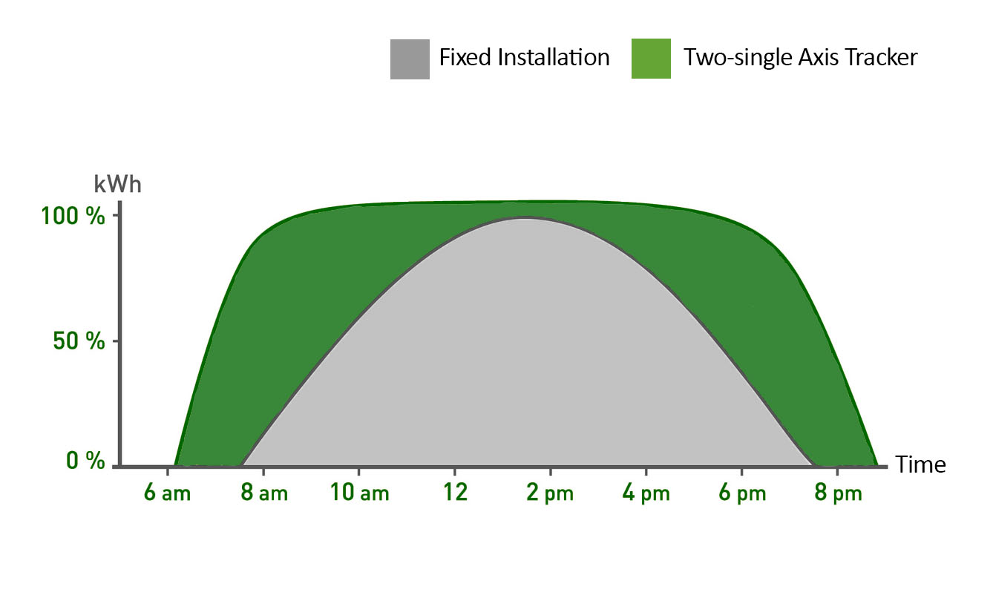
Advantages

Slide 16
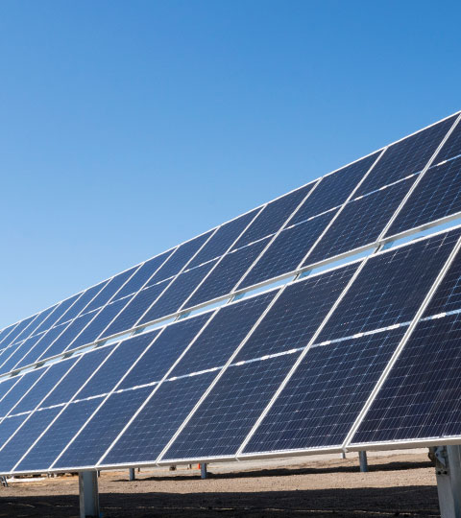
Applications
•These panels can be used to power the traffic lights and streetlights
•These can be used in home to power the appliances using solar power.
•These can be used in industries as more energy can be saved by rotating the panel.
.

Slide 17

Solar trackers may become completely autonomous
Cost and specifically LCOE will be a key driver for innovation in solar.
Future Prospects
Simplification of tracking systems will most likely become a trend

Slide 18
Summary
Experiences
Experimental Setup
Result
We all had great experience learning . We started out with planning and executing the project . Our team faced a lot problems but we overcome them .
This project taught us a lot of new things . As we started we had lot technical problems but as we fixed them we got to learn different things
After 3 months of sheer hardwork by all the group members we succeeded .

Slide 19
Members
Risheel Chheda
Sahil Kumarwar
Lavanya Tembhurne
Vishwesh Jadhav
THANK YOU

